Slide 1

OpenRAM
An Open-Source Memory Compiler
Matthew Guthaus
mrg@ucsc.edu

Slide 2

Contributors/Collaborators
Prof. James Stine & Dr. Samira Ataei (Oklahoma State)
Bin Wu, Hunter Nichols, Michael Grimes, Jennifer Sowash, Jesse Cirimelli-Low (UCSC students)
Many other past students: Jeff Butera, Tom Golubev, Marcelo Sero, Seokjoong Kim

Slide 3

OpenRAM Dependencies
Python 3.5+
Numpy
SPICE simulator
Ngspice 26 (or later)
Hspice I-2013.12-1 (or later)
CustomSim 2017 (or later)
DRC
Calibre 2017.3_29.23
Magic 8.x (http://opencircuitdesign.com/magic/)
LVS
Calibre 2017.3_29.23
Netgen 1.5 (http://opencircuitdesign.com/netgen/)
Git (any version)

Slide 4

Supported Technologies
NCSU FreePDK 45nm
Non-fabricable but contains some DSM rules
Calibre required for DRC/LVS
MOSIS 0.35um (SCN4M_SUBM)
Fabricable technology
Magic/Netgen or Calibre for DRC/LVS
4 layers metal required for supply routing
NCSU FreePDK 15nm & ASAP 7nm
In progress

Slide 5
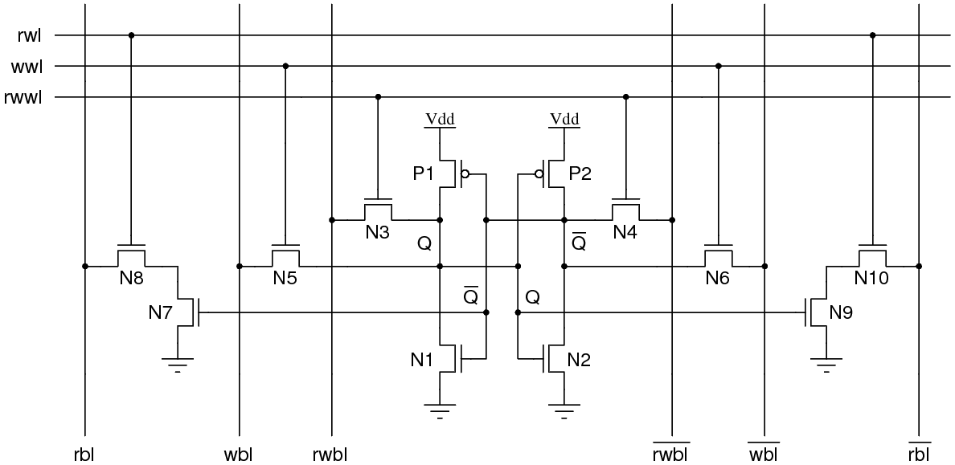
Multiport Bitcells
Based on 6T SRAM cell
Standard read-write
Isolated read-only ports
Write-only port (not sized for reads)
Can accommodate foundry bitcells

Slide 6
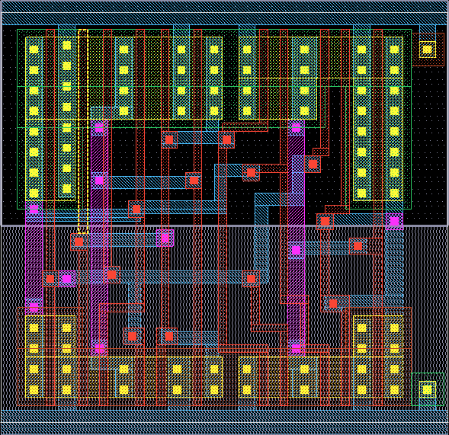
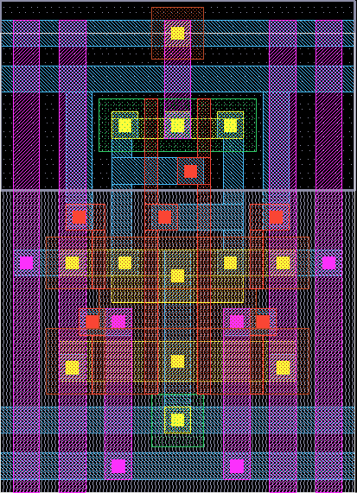
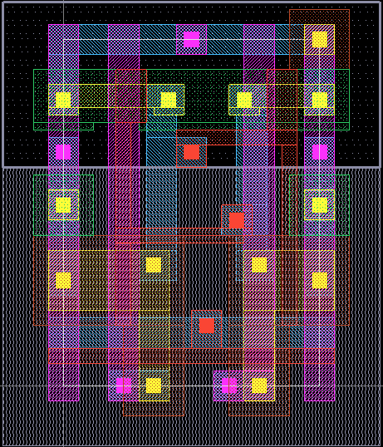
Relative Bitcell Sizes
(0.35um SCMOS)
Standard 6T (1rw) 6.8um x 9.2um
Isolated Read 10T (1rw, 1r)
10.9um x 13.9um
DFF
21.9um x 21.2um
(from OSU standard cell library)

Slide 7
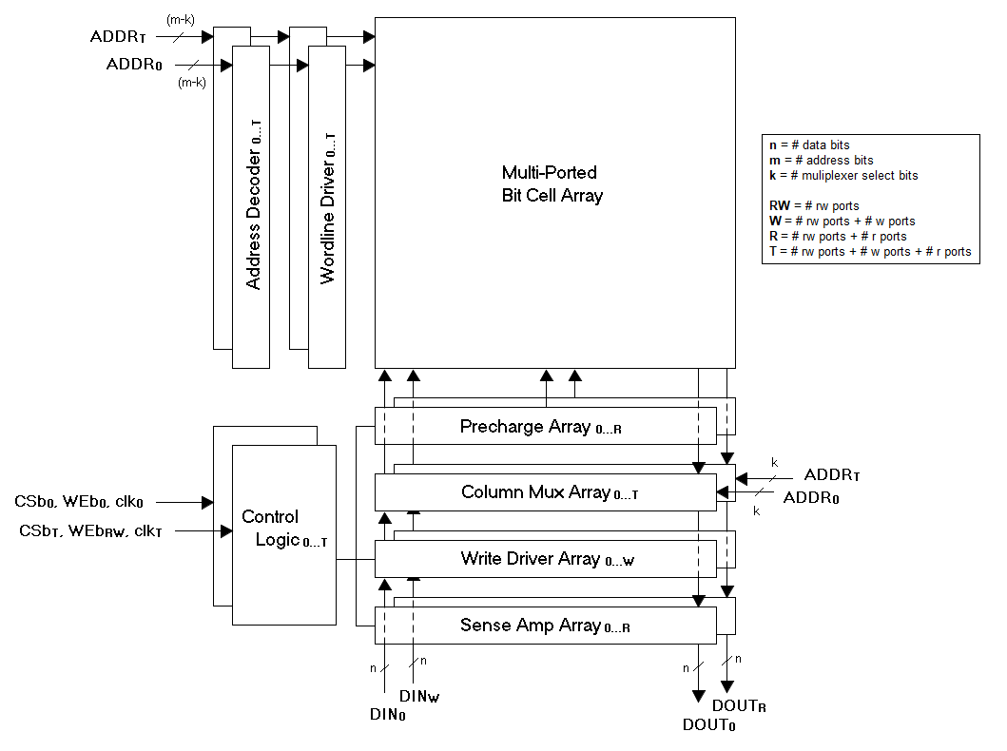
OpenRAM SRAM Architecture
Bit-cell Array
Multiport Bitcells
Each port:
Address Decoder(s)
Wordline Driver(s)
Column Multiplexer(s)
Bitline Precharge(s)
Sense Amplifier(s)
Write Driver(s)
Control Logic with Replica Bitline

Slide 8
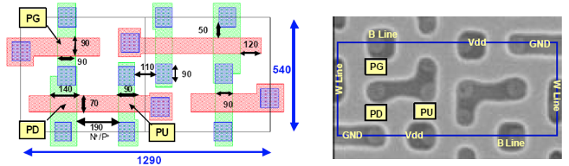
Wish list: Thin Cells
Most sub-65nm SRAMs use “thin cell” bit cells
Reduces bitline capacitance
Must reorient cell layout so poly is opposite to bitlines
But in sub-28nm, all poly must be same orientation!
Freescale 65nm cell, 0.69μm²

Slide 9
Implementation
Front-end mode
Generates SPICE, layout views, timing models
Netlist only mode can skip the physical design too
Doesn’t perform DRC/LVS
Estimates power/delay analytically
Back-end mode
Generates SPICE, layout views, timing models
Performs DRC/LVS
Can perform at each level of hierarchy or at the end
Simulates power/delay
Can be back-annotated or not

Slide 10
Technology and Tool Portability
OpenRAM is technology independent by using a technology directory that includes:
Technology’s specific information
Technology’s rules such as DRC rules and the GDS layer map
Custom designed library cells (6T, sense amp, DFF) to improve the SRAM density.
For technologies that have specific design requirements, such as specialized well contacts, the user can include helper functions in the technology directory.
Verification wrapper scripts
Uses a wrapper interface with DRC and LVS tools that allow flexibility
DRC and LVS can be performed at all levels of the design hierarchy to enhance bug tracking.
DRC and LVS can be disabled completely for improved run-time or if licenses are not available.

Slide 11
Basic Usage

Slide 12
Environment Variable Setup (assuming bash)
OPENRAM_HOME defines where the compiler directory is
export OPENRAM_HOME="$HOME/openram/compiler"
OPENRAM_TECH defines list of paths where the technologies exist
export OPENRAM_TECH="$HOME/openram/technology"
Colon separated list so you can have private technology directories
Must also have any PDK related variables set up
Add compiler to PYTHONPATH
export PYTHONPATH="$PYTHONPATH:$OPENRAM_HOME"

Slide 13
Command line usage
Basic command line (with or without py suffix):
openram.py config
openram.py config.py
Common arguments:
-t specify technology (scn4m_subm or scmos or freepdk45)
-v increase verbosity of output
-n don’t run DRC/LVS
-c perform simulation-based characterization
-d don’t purge /tmp directory contents

Slide 14
Configuration Files
Memories are created using a Python configuration file to replicate results
No YAML, json, etc.
Complete configuration options are in $OPENRAM_HOME/options.py
Some options can be specified on the command line as well
Not recommended for replicating results
# Data word size
word_size = 2
# Number of words in the memory
num_words = 16
# Technology to use in $OPENRAM_TECH
tech_name = "scn4m_subm"
# Process corners to characterize
process_corners = ["TT"]
# Voltage corners to characterize
supply_voltages = [ 3.3 ]
# Temperature corners to characterize
temperatures = [ 25 ]
# Output directory for the results
output_path = "temp"
# Output file base name
output_name = "sram_16x2”
# Disable analytical models for full characterization (WARNING: slow!)
# analytical_delay = False
# To force this to use magic and netgen for DRC/LVS/PEX
# Could be calibre for FreePDK45
drc_name = "magic"
lvs_name = "netgen"
pex_name = "magic"

Slide 15
Common configuration file options
Characterization corners
supply_voltages = [1.7, 1.8, 1.9]
temperatures = [25, 50, 100]
process_corners = [“SS”, “TT”, “FF”]
Do not generate layout
netlist_only=True
Multi-port options
num_rw_ports=1
num_r_ports=1
num_w_ports=0
Customized module or bit cell
bitcell = “bitcell_1rw_1r”
replica_bitcell = “replica_bitcell_1rw_1r”
Enable simulation characterization
WARNING! Slow!
analytical_delay=False
Output name and location
output_path = "temp"
output_name = "sram_32x256"
Force tool selection (should match the PDK!)
drc_name = "magic"
lvs_name = "netgen"
pex_name = "magic"
Include shared configuration options using Python imports
from corners_freepdk45 import *

Slide 16
Output Files
The output files are placed in the output_dir defined in the configuration file.
The base name is specified by output_name and suffixes are added.
The final results files are:
GDS (.gds)
SPICE (.sp)
Verilog (.v)
P&R Abstract (.lef)
Liberty (multiple corners .lib)
Datasheet (.html)
Log (.log)
Configuration (.py) for replication of creation

Slide 17
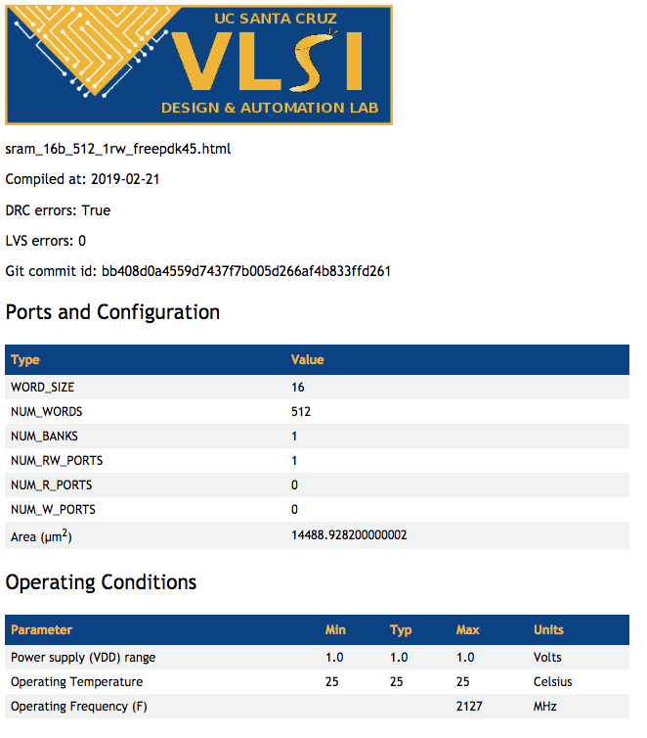
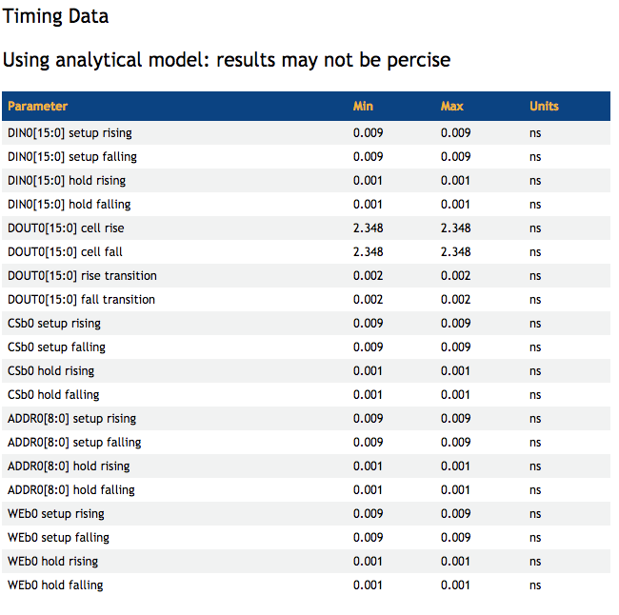
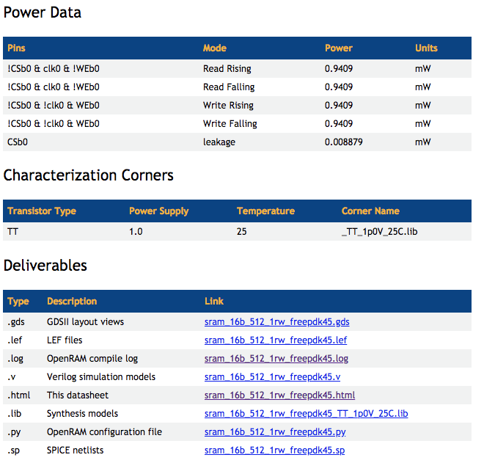
Data Sheets

Slide 18
Debugging and Unit Testing

Slide 19
Unit Tests
OpenRAM has the set of thorough regression tests implemented with the Python unit test framework:
Unit tests allow users to add features without worrying about breaking functionality.
Unit tests guide users when porting to new technologies.
Every sub-module has its own regression test.
There are regression tests for memory functionality, library cell verification, timing verification, and technology verification.

Slide 20
Unit Test Organization
00_code_format_test.py does basic lint checking.
01_library_drc_test.py checks DRC of all library cells for the technology.
02_library_lvs_test.py checks LVS of all library cells for the technology.
03_*_test.py checks DRC and LVS of wires and transistors classes.
04_*_test.py checks DRC and LVS of parameterized cells.
05-19_*_test.py checks DRC and LVS of module cells (moving upward in hierarchy with numbers)
20_*_test.py check DRC and LVS of full SRAM layouts with various configurations.
21_*_test.py checks timing of full SRAMs and compares (with tolerance) to precomputed result.
NOTE: These tests may fail using different simulators due to the tolerance level.
22_*_test.py checks functional simulation of full SRAMs with various configurations.
23-25_*_test.py checks lib, lef, and verilog outputs using diff.
30_openram_test.py checks command-line interface and whether output files are created.

Slide 21
Running Unit Tests
Tests can be run in the $OPENRAM_HOME/tests directory
Command line arguments
-v for verbose
-t freepdk45 for tech
-d to preserve /tmp results (done automatically if test fails)
Individual tests
01_library_drc_test.py
All tests
regress.py

Slide 22
Successful Unit Tests
openram/compiler/tests$ ./regress.py ______________________________________________________________________________
|==============================================================================|
|========= Running Test for: =========|
|========= scn4m_subm =========|
|========= ./regress.py =========|
|========= /tmp/openram_mrg_13245_temp/ =========|
|==============================================================================|
runTest (00_code_format_check_test.code_format_test) ... ok
runTest (01_library_drc_test.library_drc_test) ... ok
runTest (02_library_lvs_test.library_lvs_test) ... ok
runTest (03_contact_test.contact_test) ... ok
runTest (03_path_test.path_test) ... ok
etc.
openram/compiler/tests$ ./03_ptx_1finger_nmos_test.py
______________________________________________________________________________
|==============================================================================|
|========= Running Test for: =========|
|========= scn4m_subm =========|
|========= ./03_ptx_1finger_nmos_test.py =========|
|========= /tmp/openram_mrg_13750_temp/ =========|
|==============================================================================|
.
----------------------------------------------------------------------
Ran 1 test in 0.596s
OK

Slide 23
Debugging Unsuccessful Unit Tests (or openram.py)
You will get an ERROR during unit test and see a stack trace
Examine the temporary output files in the temp directory (/tmp/mydir)
______________________________________________________________________________
|==============================================================================|
|========= Running Test for: =========|
|========= scn4m_subm =========|
|========= ./04_pinv_10x_test.py =========|
|========= /tmp/mydir =========|
|==============================================================================|
ERROR: file magic.py: line 174: DRC Errors pinv_0 2
F
======================================================================
FAIL: runTest (__main__.pinv_test)
----------------------------------------------------------------------
Traceback (most recent call last):
File "./04_pinv_10x_test.py", line 22, in runTest
self.local_check(tx)
File "/Users/mrg/openram/compiler/tests/testutils.py", line 45, in local_check
self.fail("DRC failed: {}".format(a.name))
AssertionError: DRC failed: pinv_0
----------------------------------------------------------------------
Ran 1 test in 0.609s
FAILED (failures=1)

Slide 24
It didn’t finish... where are my files?
OpenRAM puts all temporary files in a temporary directory named:
/tmp/openram_<user>_<pid>_temp
This allows multiple processes/users to simultaneously run
This allows /tmp to be mapped to a RAM disk for faster performance
After a successful run, the directory and contents are deleted
To preserve the contents, you can run with the “-d” option for debugging
OPENRAM_TMP will override the temporary directory location for debug
export OPENRAM_TMP=”/home/myname/debugdir”

Slide 25
Temporary Output Files
DRC standard output (*.drc.out), errors (*.drc.err), and results (*.drc.results)
LVS standard output (*.lvs.out), errors (*.lvs.out), and results (*.lvs.results)
GDS (and Magic) files for intermediate modules (temp.gds, temp.mag)
SPICE netlist for intermediate module results (temp.sp)
Extracted layout netlist for intermediate module results (extracted.sp)
Magic only: Run scripts for DRC (run_drc.sh) and LVS (run_lvs.sh)
Calibre only: Runset file for DRC (drc_runset) and LVS (lvs_runset)

Slide 26
Technology Setup

Slide 27
Technology Directories
Environment variable OPENRAM_TECH specifies list of technology directories
Similar to *nix $PATH
Directory structure
techname/
__init__.py -- Sets up PDK environment
tech/ -- Contains technology configuration
__init__.py -- Loads all modules
tech.py -- SPICE, DRC, GDS, and layer config
gds_lib/ -- Contains .gds files for each lib cell
sp_lib/ -- Contains .sp file for each lib cell
models/ -- Contains SPICE device corner models
(tf/) -- May contain some PDK material
(mag_lib/) -- May contain other layout formats

Slide 28
Technology Configuration: Layer Map
Layer map contains mapping of layer names to GDS layers
Layer names are used in OpenRAM code directly
layer={}
layer["vtg"] = -1
layer["vth"] = -1
layer["contact"] = 47
layer["pwell"] = 41
...
layer["metal4"] = 31
layer["text"] = 63
layer["boundary"] = 63
layer["blockage"] = 83

Slide 29
Technology Configuration: GDS
OpenRAM uses the GDSMill library (included and heavily modified)
Units defined for GDS format
First number is DB units per user units
Second number is DB unit in meters
Zoom defines default zoom for labels
More info on the GDS format at:
http://boolean.klaasholwerda.nl/interface/bnf/gdsformat.html
#GDS file info
GDS={}
# gds units
GDS["unit"]=(0.001,1e-6)
# default label zoom
GDS["zoom"] = 0.5

Slide 30
Technology Configuration: DRC
Creates the design_rule class with several parts:
Grid size
Location of DRC, LVS, PEX rules and layer map
Subset of design rules for FEOL and BEOL
Design rules have common naming scheme (names used in OpenRAM)
minwidth_<layer>
<layer>_to_<layer>
<layer>_extend_<layer>
minarea_<layer>
Allows rule tables for complex rules
# Minimum spacing of metal3 wider than 0.09 & longer than 0.3 = 0.09
# Minimum spacing of metal3 wider than 0.27 & longer than 0.9 = 0.27
# Minimum spacing of metal3 wider than 0.5 & longer than 1.8 = 0.5
# Minimum spacing of metal3 wider than 0.9 & longer than 2.7 = 0.9
# Minimum spacing of metal3 wider than 1.5 & longer than 4.0 = 1.5
drc["metal3_to_metal3"] = drc_lut({(0.00, 0.0) : 0.07,
(0.09, 0.3) : 0.09,
(0.27, 0.9) : 0.27,
(0.50, 1.8) : 0.5,
(0.90, 2.7) : 0.9,
(1.50, 4.0) : 1.5})

Slide 31
Technology Configuration: SPICE
Device models (and corners)
Defaults simulation values
Voltage
Temperature
Feasible period for simulation
Rise/fall input slews
Analytical parameters
For example, device capacitance and “on” resistance
Used for analytical delay and power estimation

Slide 32
Technology Configuration: Parameters
Default design parameters
Being cleaned up and standardized...
Defaults simulation values
Voltage
Temperature
Feasible period for simulation
Rise/fall input slews
Analytical parameters
Used for analytical delay and power estimation
E.g. device capacitance and “on” resistance

Slide 33
Library Cells

Slide 34
Required Hard/Custom Cells
Located in
$OPENRAM_TECH/<tech>/gds_lib
$OPENRAM_TECH/<tech>/sp_lib
A few library cells with layout and SPICE:
Bitcell (and dummy and replica bitcell)
Sense amplifier
DFF (from a standard cell library)
(Removing soon: write driver, tristate)
P&R border layer defined for placement
Sense amplifier pitch matched width to bitcell
Standard 6T (1rw) 6.8um x 9.2um

Slide 35
Bitcell(s)
Python code is in $OPENRAM_HOME/bitcells
Layout in $OPENRAM_TECH/<tech>/gds_lib
SPICE in $OPENRAM_TECH/<tech>/sp_lib
Can be a foundry bitcell if you have the GDS and SPICE.
May include multiple port configurations:
bitcell.py uses cell_6t.{gds,sp} - standard 1rw port
bitcell_1w_1r.py uses cell_1w_1r.{gds,sp} for 1w and 1r port
bitcell_1rw_1r.py uses cell_1rw_1r.{gds,sp} for 1rw and 1r port
Wish list: pin names are fixed right now as bl, br, wl, vdd, gnd

Slide 36
Multiport Bitcells
Based on 6T SRAM cell
Standard read-write
Isolated read-only ports
Write-only port (not sized for reads)
Can accommodate foundry bitcells

Slide 37
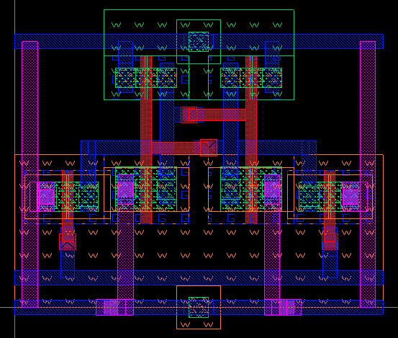
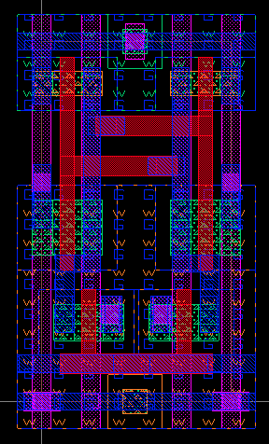
Parameterized Bitcell
If a custom bitcell is not available, we create one with user design rules.
Not good for area, but may still be better than DFFs.
Can be useful for simulation/functional work before custom bitcell is available.
Example 1 RW pbitcell compared to custom 1RW

Slide 38
Sense Amplifier
Needs a sense amplifier that is pitch matched to the bitcell.
$OPENRAM_TECH/gds_lib/sense_amp.gds
$OPENRAM_TECH/sp_lib/sense_amp.sp
$OPENRAM_HOME/modules/sense_amp.py
Wish list: pin names are fixed right now as bl, br, dout, en, vdd, gnd

Slide 39
DFF
Needs a standard cell DFF for the address and data registers.
$OPENRAM_TECH/gds_lib/dff.gds
$OPENRAM_TECH/sp_lib/dff.sp
$OPENRAM_HOME/modules/dff.py
Have auxiliary code to create:
Buffered DFFs (dff_buf.py) using dynamically generated inverters (pinv)
Inverted output DFFs (dff_inv.py) using a dynamically generated inverters (pinv)
2-D DFF arrays
Regular DFF arrays (dff_array.py)
Buffered DFF arrays (dff_buf_array.py)
Inverted DFF array (dff_inv_array)
Wish list: pin names are fixed right now as D, Q, Qb, clk, vdd, gnd

Slide 40
Tristate/Write Driver
Tristate is used for multi-bank implementations
Write driver drives the data onto the bitlines
Both of these are currently library cells, but plans are to make them dynamically generated (ptristate.py and pwrite_driver.py)

Slide 41
Base Data Structures

Slide 42
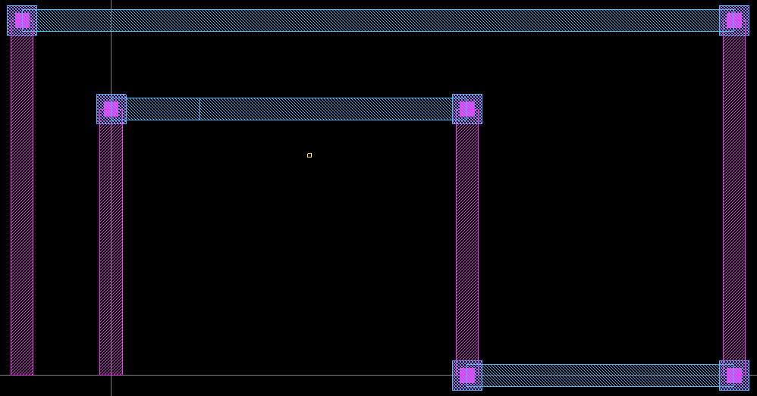
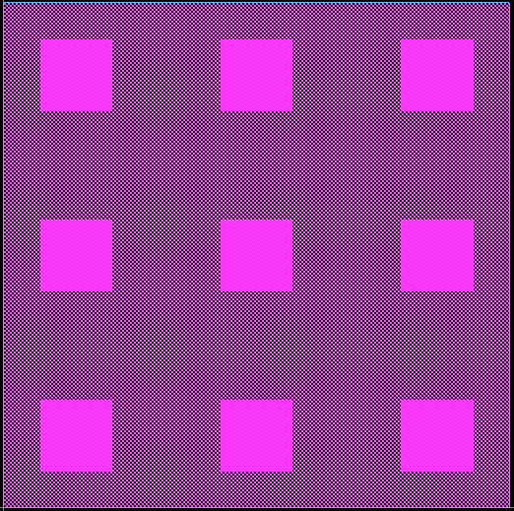
Design Classes
SPICE and GDS2 Interfaces
Custom cells (read GDS and SPICE)
Generated cells (creates GDS and SPICE “on the fly”)
Netlist functions
Add (directional) pins
Add and connect instances
Layout functions
Place instances
Add wires, routes, vias
Channel and Power router
Verification functions (wrap around DRC and LVS tools)

Slide 43
Base Class Inheritance
design.py
General design and helper DRC constants
hierarchy_design.py DRC/LVS functions
hierarchy_spice.py Netlist related functionality
hierarchy_layout.py Layout related functionality
Functions: add_pins add_inst
sp_read sp_write Power data
Delay data
Functions:
add_{layout_pin,rect,...} place_inst create_channel_route etc.
gds_read
gds_write
get_blockages etc.

Slide 44
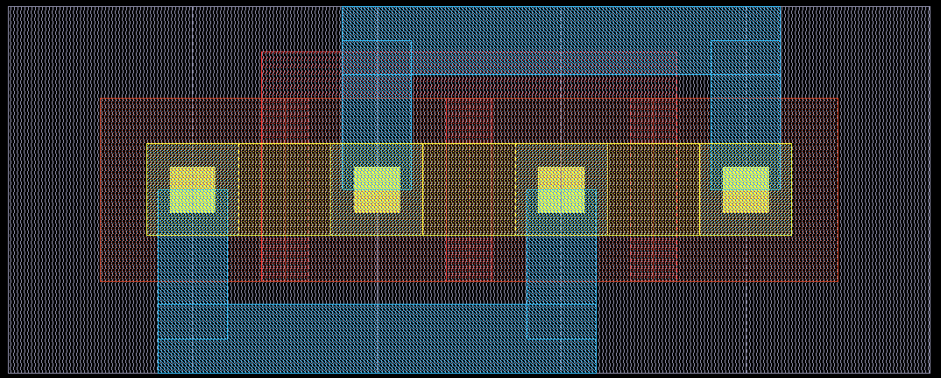
Parameterized Transistor (ptx or pfinfet)
Creates variable size/finger nmos or pmos transistor
Optional gate and source/drain contacts in naive way
Not optimal layout, but “good enough”
Offset (0,0) is lower-left corner of active area
Size/fingers effect on size must be estimated elsewhere perhaps by trying configurations

Slide 45
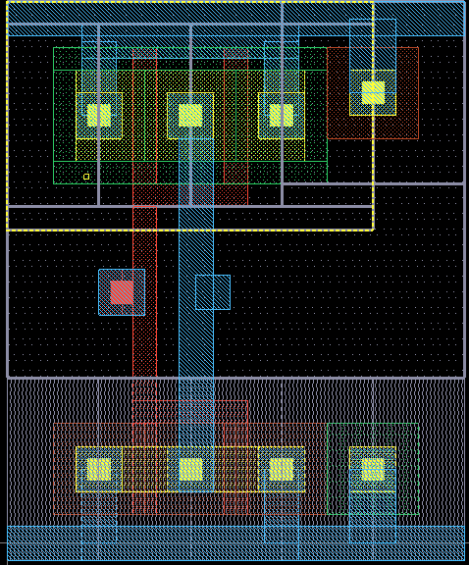
Parameterized Cells
Dynamically generated cells (in $OPENRAM_HOME/pgates)
Not the most efficient layouts but “ok”
Try to use restrictive design rules to keep them portable
Transistors
ptx, pfinfet
Logic gates
pinv, pnand2, pnand3, pnor2,
Buffer/drivers
pbuf, pinvbuf, pdriver
SRAM Logic
precharge, single_level_column_mux

Slide 46
Hierarchical Design Modules

Slide 47
Hierarchical Design Modules
Memory building blocks
SRAM, Bank, Control Logic, Decoders, Column Mux, Various arrays (DFF, drivers)
Can override every module with a custom one in the configuration file
Each module must:
Create netlist
Define inputs/outputs
Instantiate and connect sub-modules and cells
Create layout
Place and route itself
Route vdd/gnd to M3
(Optional) Run DRC/LVS
Analytically model timing and power

Slide 48
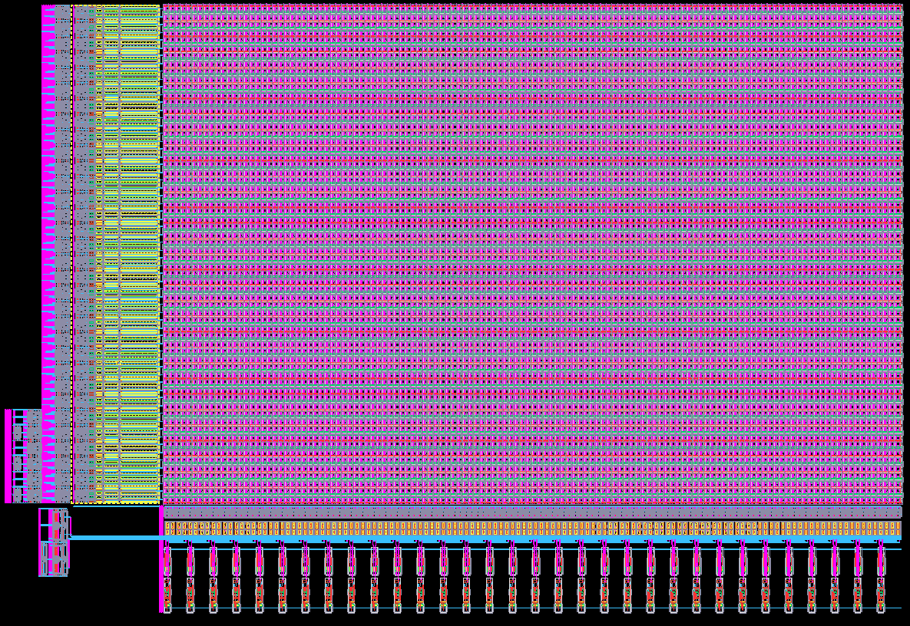
Bank
Encompasses everything except
Data and Address Flops
Control logic
Multi-bank logic
Arranges ports
Port 0 is left/bottom
Port 1 is right/top

Slide 49
Port Data
Encapsulates all of the datapath logic for a rw, w, or r port
Sense amplifiers (read types)
Write drivers (write types)
Column mux (if any)
Precharge (read or write type) (write to not destroy half selected cells in a row)
Also includes a precharge for the replica columns

Slide 50
Port Address
Encapsulates the row decoder and wordline driver for easier placement next to a bank
Each port will have its own port_address module

Slide 51

Plain Bitcell Array
2D Array of bit cells
Each row alternately flips vertically
Assume bitcells tile
Boundary is determined by boundary layer in GDS
Word line must abut
Bit lines must abut

Slide 52
Variations of Bitcells Needed
Normal bitcell for data storage
Replica bitcell that is fixed to output a 0 value
Dummy bitcell with bitlines disconnected (purely for wordline load and lithography regularity)

Slide 53
Replica Bitcell Array
D
D
D
D
D
D
D
D
D
D
R
D
Bitcells: B=regular, D=dummy, R=replica
Main bitcell array (green)
Replica cols for each read port (blue) on left or right (any number)
Dummy bitcells on the top, bottom, left, and right for lithography regularity (red)
Replica columns activate two replica bitcells
One driven by replica wordline
Second driven by one of the normal wordlines
Second port word and bit lines not shown
Would be on right and top
wl0_3
D
R
B
B
R
D
wl0_2
D
R
B
B
R
D
wl0_1
D
R
B
B
R
D
wl0_0
D
R
B
B
R
D
rbl_wl0
D
R
D
D
D
D
D
D
D
D
D
D
rbl_bl0
bl0_0
bl0_1
rbl_br0
br0_0
br0_1

Slide 54
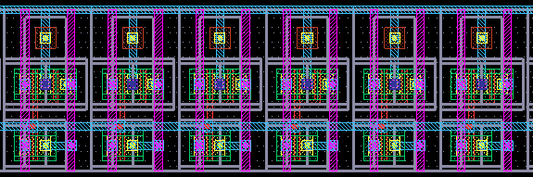
1D Arrays
Several modules have 1D arrays:
sense_amp_array
write_driver_array
precharge_array
single_level_column_mux_array
tri_gate_array
wordline_driver (*should change name to _array)
Sense_amp_array, write_driver_array, tri_gate_array match column mux stride to space out
Wish list: Allow wide sense amplifier array to use multiple rows of sense amplifiers.

Slide 55
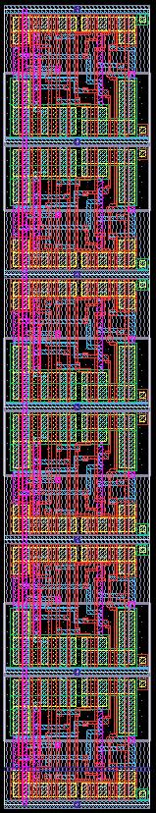
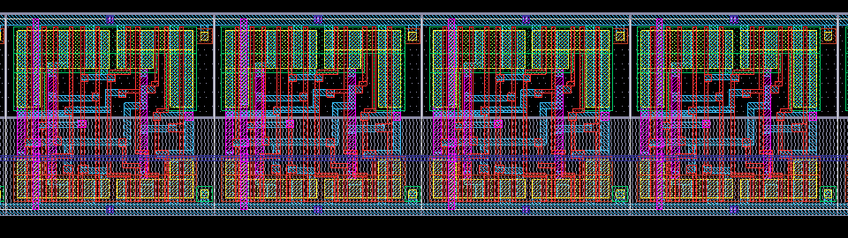
2D Arrays
Regular DFF arrays (dff_array.py)
Buffered DFF arrays (dff_buf_array.py)
Inverted DFF array (dff_inv_array)
Can be 1xN or Nx1 or MxN
Wish list: MxN routes pins to edges

Slide 56
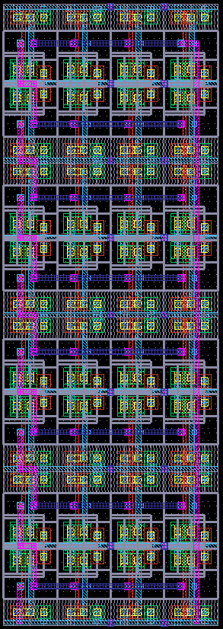
Delay Line
Configurable fanout and stages
[4,4,4] means 3 FO4 stages
[1,1,4,4] means 2 FO1 stages followed by FO4

Slide 57
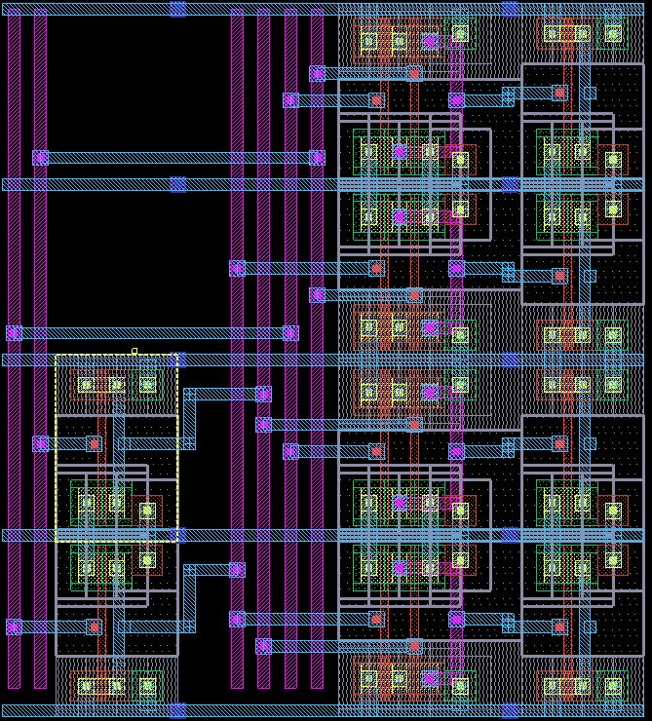
Hierarchical (Address) Decoder
Generic hierarchical_predecode class
Places routing rails and decode inverters
Derived to implement multiple predecoders
hierarchical_predecode_2x4
hierarchical_predecode_3x8
hierarchical_predecode_4x16
Hierarchical decoder uses predecoder + another decode stage
Predecoders are also used for the column mux decode and bank select decode
Wish list: Handle thin bitcell height

Slide 58
Control Logic and Timing

Slide 59
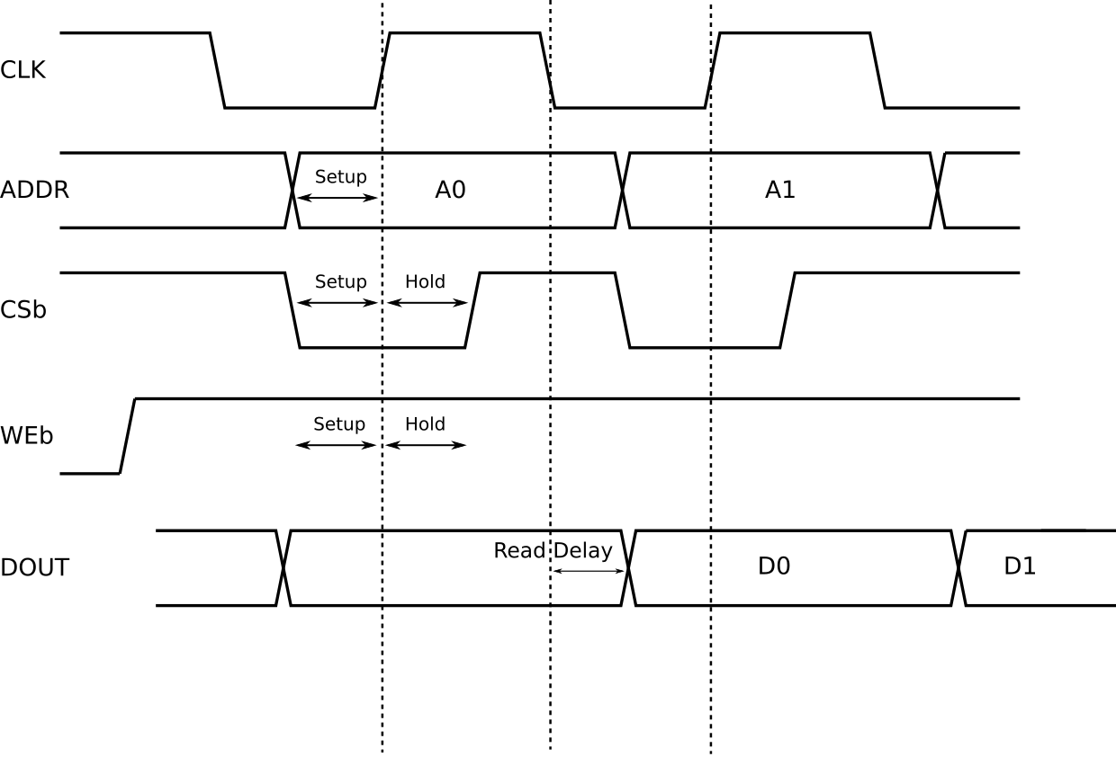
Read Timing

Slide 60
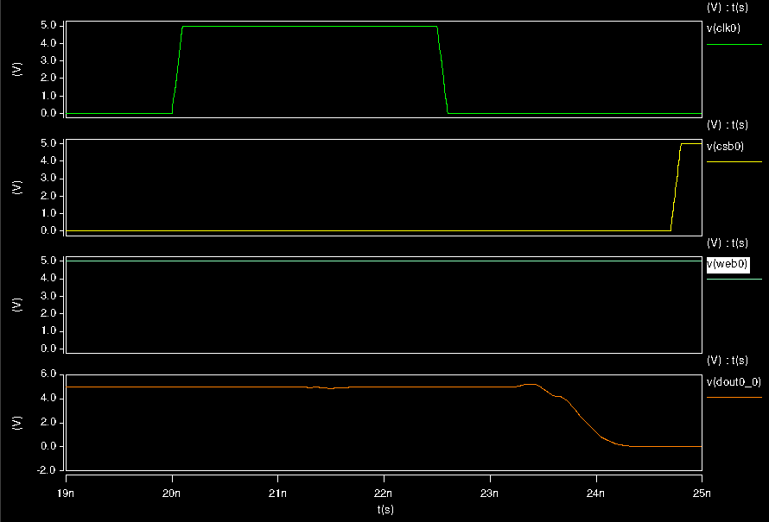
Read Timing Simulation

Slide 61
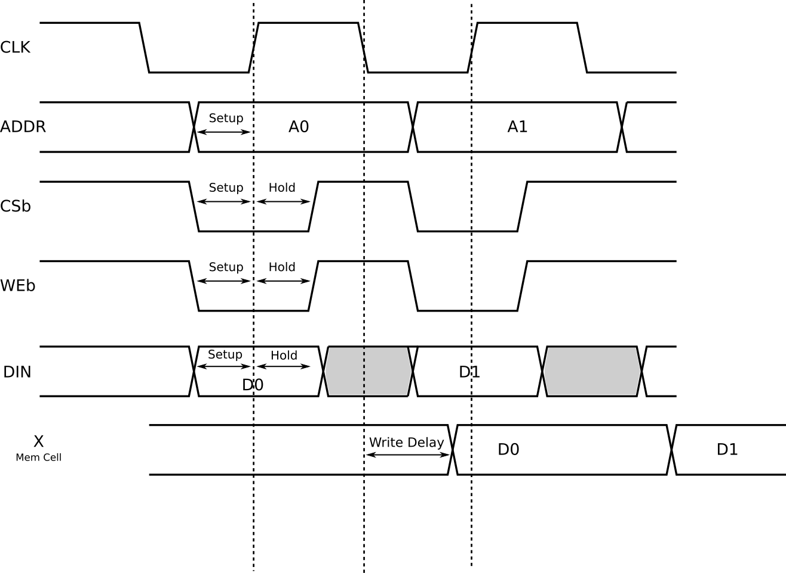
Write Timing

Slide 62
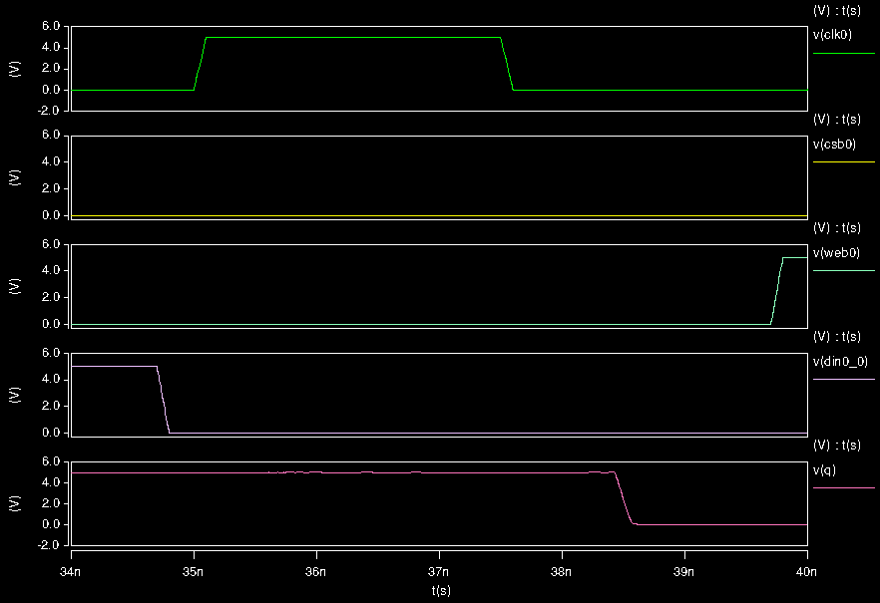
Write Timing Simulation

Slide 63
External Control Signals
Behaves as a synchronous register interface
Address and data captured on positive edge
Data is available after the negative edge (before next positive edge)
Clock is used for internal control generation
Clock cycle
Clock high: capture inputs + precharge + decode
Clock low: read/write
Reads and writes on multiple ports to the same address in the same cycle “feed through” but the noise margins of the bitcell must be able to handle this

Slide 64
Internal Control Signals
Sense Enable (s_en) -- Active high sense amp enable from Replica Bit Line (RB)
RBL input: rbl_wl = gated_clk_bar & we_bar
Delayed RBL output: pre_s_en = DELAY(rbl_bl)
Buffered enable: s_en = BUF(pre_s_en)
Write Driver Enable (w_en) -- Active high write driver enable
w_en = we
we is directly from control flops
Precharge Enable Bar (p_en_bar) -- Active low enable of precharge
p_en_bar = !(gated_clk_bar)
Active for writes as well to prevent half select destruction
Word line enable (wl_en) -- Active high word line enable
wl_en = BUF(gated_clk_bar)

Slide 65
Replica Bitline (RBL)
Replica Bitcell Array
Replica Column
Bitcell Array
Determines when to start sensing by replicating a bitcell array column
Replica Bitline Column (RBC) matches transition of column
rbl_bl = RBC(rbl_wl)
Delay Line delays the input signal to match word line driver
pre_s_en = DELAY(rbl_bl)
Buffer drives s_en signal to sense amps
rbl_wl
Replica Column is actually a part of the replica bitcell array to the match lithographic environment and wordline load.
rbl_bl
Delay Line
s_en
pre_s_en

Slide 66
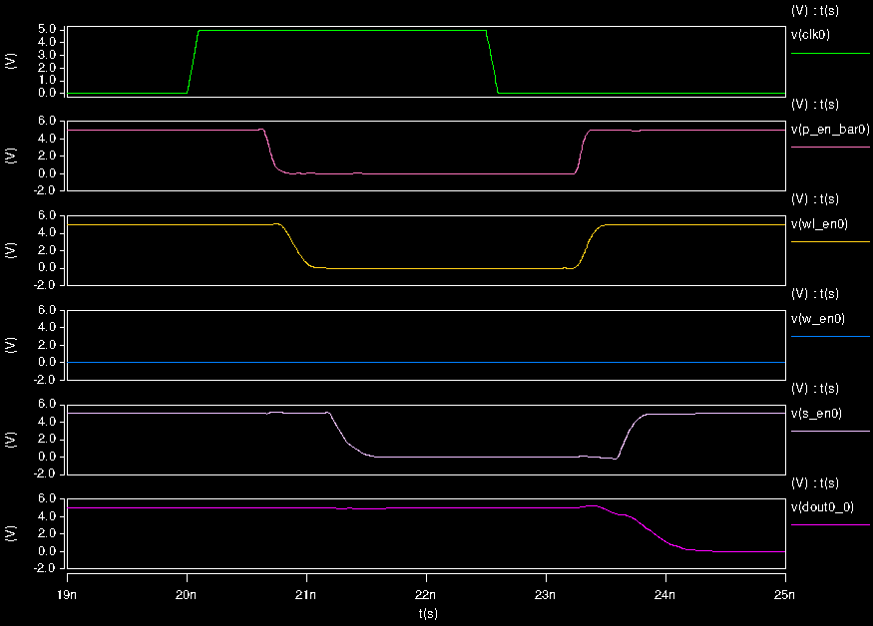
Internal Control Signals Diagram (Read)

Slide 67
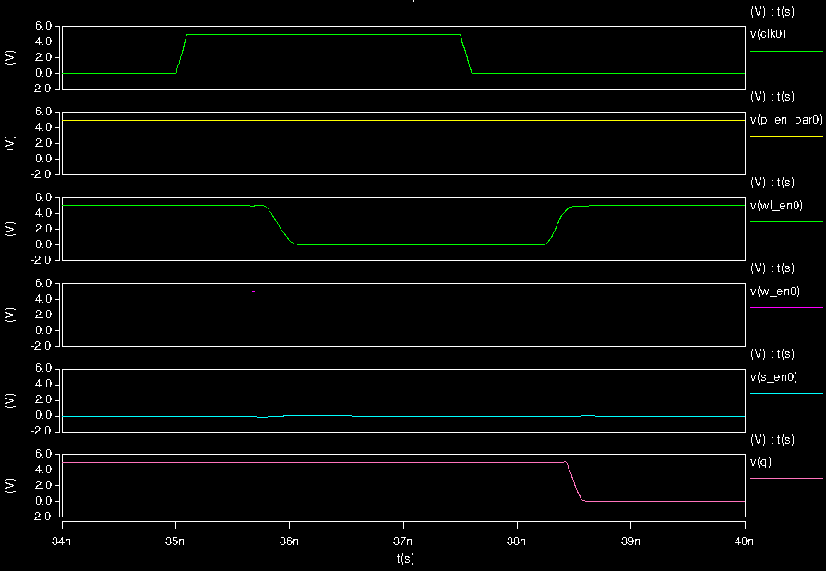
Internal Control Signals Diagram (Write)

Slide 68
Clock Distribution
External clock (clk)
Buffered clock (clk_buf) drives all DFFs in the design
clk_buf = BUF(clk)
Buffered clock bar (clk_bar) used in control logic
clk_bar = INV(clk_buf)
Gated Clocks (gated_clk and gated_clk_bar) used in control logic
This is LOW when disabled
gated_clk_bar = cs && clk_bar
This is LOW when disabled
gated_clk = cs && clk_buf

Slide 69
Routing

Slide 70
Power Supply Options
Unrouted
Leave must-connect metal 3 pins for vdd and gnd within the array
Grid
Connect in a metal 3 and 4 grid
Blockage aware
Can encounter DRC errors with off-grid pins
Works with commercial tools but not so well with OpenRoad
Work in Progress: Hanan Grid / Steiner Tree:
Route tree on Hanan metal 3 and 4 grid instead of full grid
Blockage aware

Slide 71
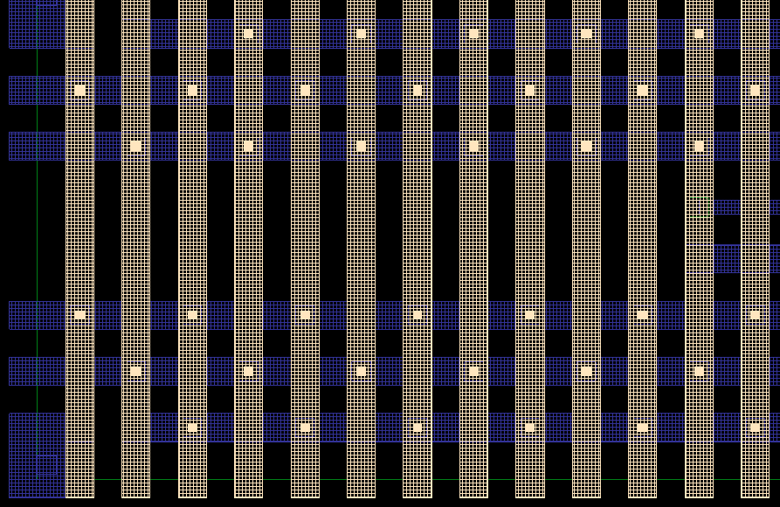
Power Routing
All power pins are brought to M3 and routed as a grid on M3/M4
Considers blockages of M3/M4 by control and data signals
Considers wide/long metal spacing rules

Slide 72
Power Supply Algorithm
1st: Route vertical and horizontal grids (blockage aware, allow connection to correct supply)
2nd: Check direct overlaps of power pins
3rd: Single direction probes to connect
4th: A* maze router

Slide 73
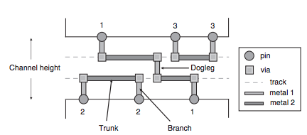
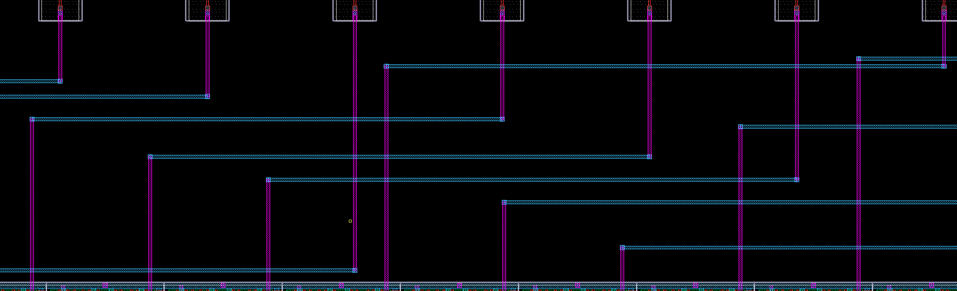
Channel Router
SRAMs typically try to use minimal layers of metal
Primarily used to connect decoders, input/output circuitry, or control logic
Wish list
Minimize number of tracks
Must consider impact on floorplan
Credit: Chen & Chang, EDA Handbook, Chapter 12, Global and detailed routing
Sense amp to data flop connection

Slide 74
Characterization

Slide 75
Characterization Overview
Measures the timing/power through SPICE simulation:
Generates the SPICE stimulus: The stimulus is written in standard SPICE format and can be used with any simulator that supports this.
Runs the circuit simulations: To produce the average power, setup/hold times, and timing delay of the memory design.
Parses the simulator’s output: The setup time, hold time, and delay are found using a bidirectional search technique.
Produces the output in a Liberty (.lib) file.

Slide 76
Characterizer Organization
Core Modules
delay.py - Generates the delays and power of input SRAM and corner
setup_hold.py - Generates setup and hold timing of DFFs by corner
lib.py - Characterizes SRAM and builds Liberty file
stimuli.py - Generates SPICE stimulus file for characterization
Auxiliary Modules
simulation.py - Base class for SRAM characterization modules
trim_spice.py - Removes portions of SRAM SPICE to speedup simulation
measurements.py - Contains classes to aid SPICE measurements
char_utils.py - Contains common functions used during characterization
logical_effort.py - Helper class for analytical delay model
Testing Support Modules
Other modules are derivatives of the simulation module used in the unit tests

Slide 77
Characterization Options
Characterization by Configuration File
The process, voltage, and temperature (PVT) for characterization are defined in the config file.
Running OpenRAM generates a Liberty (.lib) file for every corner characterized.
Delays, slews, power determined for each input slew and outputs load combination in config file.
OpenRAM Characterization Mode
Supports analytical and SPICE based characterization
Analytical characterization is default
SPICE characterization enabled with -c flag (requires SPICE simulator)

Slide 78
Characterization Measurements
Characterization is performed primarily to generate tables in .lib file
cell_rise/cell_fall - Delay of from neg. clock edge to DOUT when reading a 1 or 0 respectively
rise_transition/fall_transition - Slew of DOUT when read 1 or 0 respectively
Setup and hold time for inputs (setup_rising, hold_rising)
Total power and leakage power
Delays and slews and intended to be independent of clock period.
Fall delays are copied to rise delays after characterization*
Characterizer can help with debugging or optimization
Delay characterizer also produces Sense Amp Enable Timing to help debug read failures.
Delay class can edited or can be base class if other measurements are wanted.
*Note: Rise delays are dependent on the clock period if measured from negative clock edge due to precharge.

Slide 79
Analytical Characterization
Delay
Assumes a worst case delay through decoder, word line, and bit lines
Calculates RC delay at each stage using parameters for handmade cells, unit capacitances, and unit resistances which are defined in the technology setup
Output slews are estimated based on delays
Wire delays only estimated for bitline delay
Power
Dynamic power at each stage calculated using C * V² * Frequency
Leakage power estimated with parameters in technology setup
Corners add linear variations in delay and power

Slide 80
Multiport Characterization
Supports any port configuration specified by the configuration file
Any number of Read, Write, and Read/Write ports
Any custom bitcells may require modifications for characterization
Characterization Algorithm
Feasible period found for each port
Common minimum period is found for all ports
Power and delay is characterized on each port
Characterization Runtime
Ports are characterized separately for accuracy
Runtime increases linearly with ports and can be slow.

Slide 81
Characterizer Unit Test Use
OpenRAM will use the characterizer to generate data for .lib by default
Characterizer modules can be instantiated separately from lib.py to generate and test data
Example: 21_ngspice_delay_test.py
Delay module generates data to compare against previously generated data to error check any recent OpenRAM changes having a large effect on the delay
Delay/Simulation module can be used as base class and altered to include custom measurements

Slide 82
Functional Simulation
Assumes uninitialized memory
Random operations
Uses multiple ports when available
Read, write, or noop
Random address
Random data
Memory checks
Uses standard CMOS noise margins
Compares read with last write (or feed-through value if being written)

Slide 83
Power/Delay Characterization
Prunes unused portions of circuit for run-time
Setup time, hold time, and delay are found using a bidirectional search.
Finds a feasible period
Iterates until convergence
Dynamic and leakage measured
Output saved in Liberty (.lib) file.
Uses NLDM
Wish list: CCS

Slide 84
Timing Graph
OpenRAM has SPICE like modules and instances
A timing graph is created using the SPICE netlist, names and paths through lower level modules.
Graph used in characterizer for debugging timing issues associated with the Sense Amp Enable

Slide 85
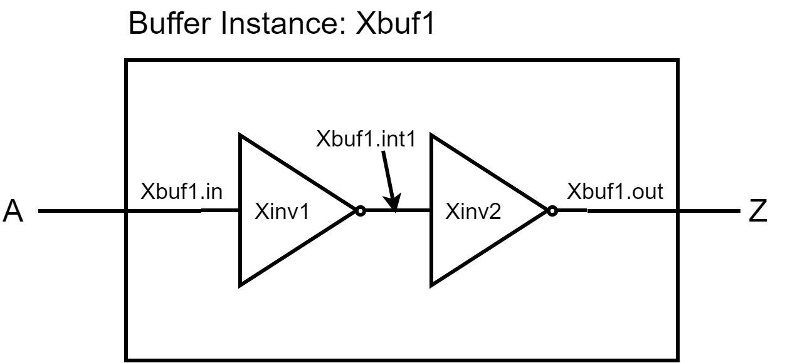
Graph Creation Example: Buffer
SPICE instantiated module (vdd, gnd excluded from graph)
Xbuf1 A Z vdd gnd Buffer
Base module has its own naming for ports and internal signals

Slide 86
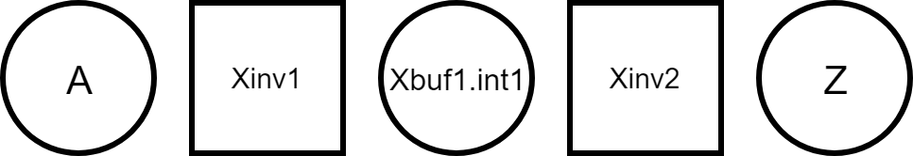
Graph Creation Example: Buffer
Node names reduced to top-most SPICE level with internal signals maintained.
Internal modules determine edges between nodes

Slide 87
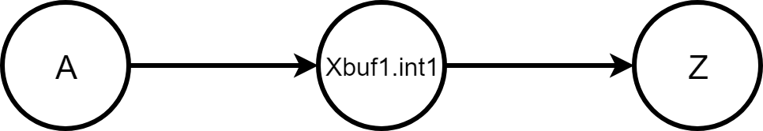
Graph Creation Example: Buffer
Most lower level modules (gates, PTX, FF, etc) determine edges by connecting every input to every output by default.
Custom timing paths can be overridden in any module

Slide 88
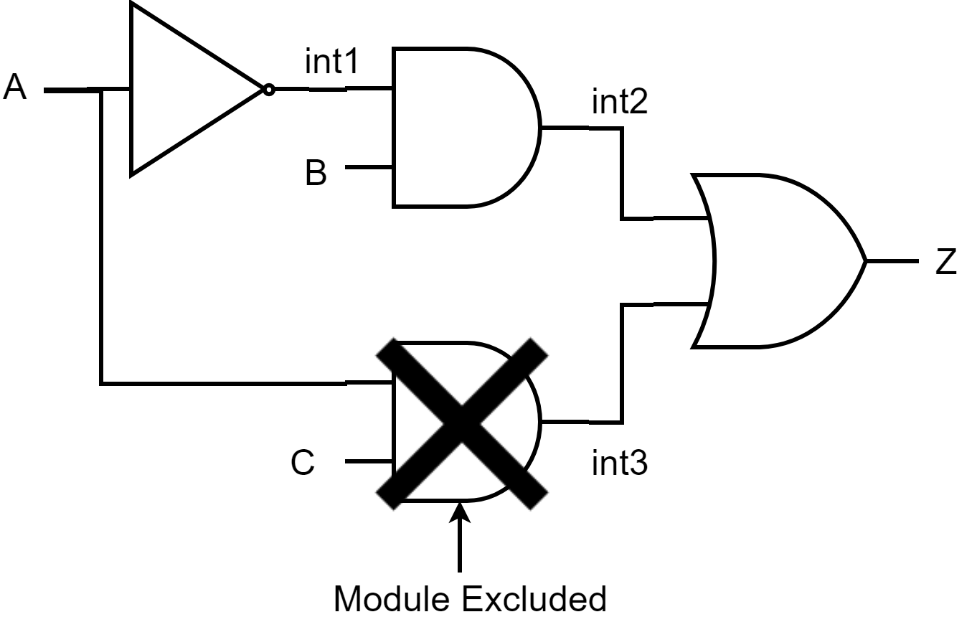
Graph Module Exclusion
Modules can be excluded from the graph before it’s built
This can help trim timing paths that are known to not affect the overall timing

Slide 89
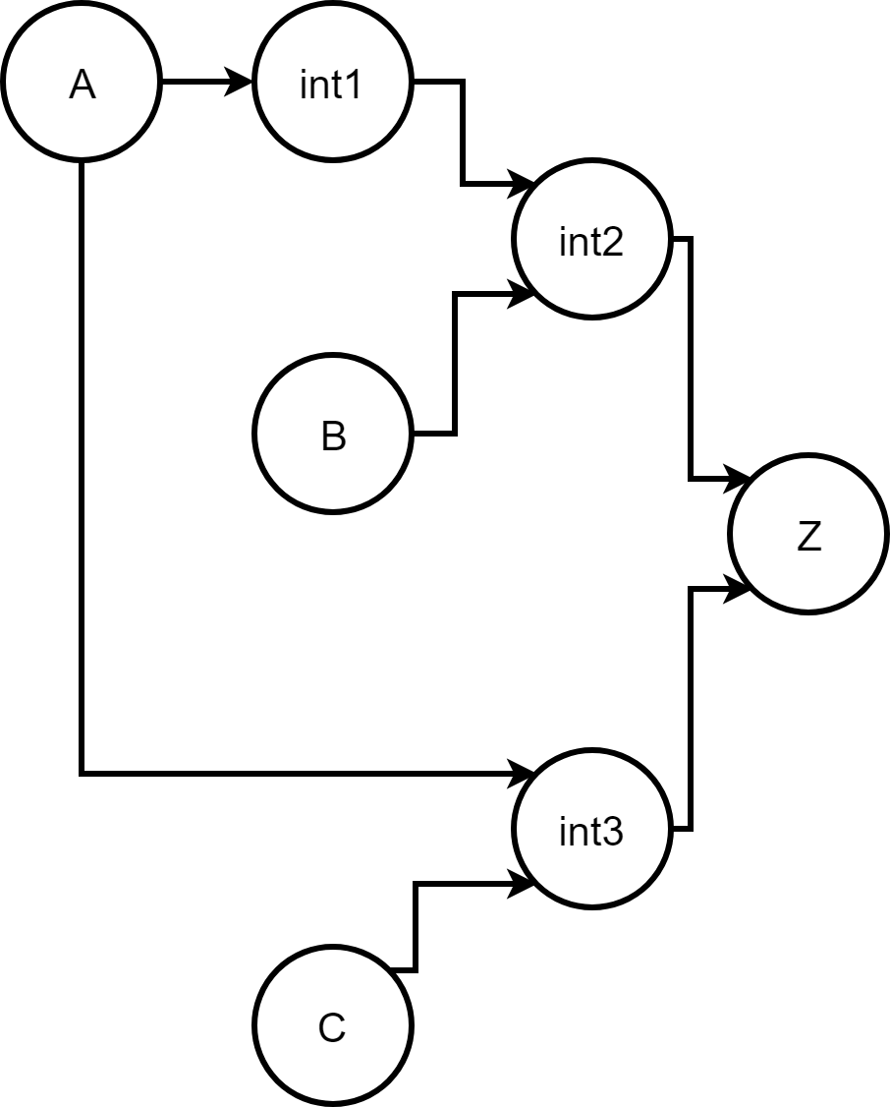

Graph Module Exclusion
Graph without Exclusion
Graph with Exclusion

Slide 90
Timing Measurement Checks
In addition to measurements done for characterization. Several measurements are done to help debug memory failures.
Bitline measurements - Voltage of bitlines measured the checked to have at least a 10% difference
Bitcell Measurements - Voltage measured on internal storage of cells and check that they match the operation.
Output voltage measurements - Output voltage (DOUT) checked at end of cycle so it matches operation.
Sense Amp Enable Timing - Delay of S_EN should not exceed a half-period

Slide 91
Results

Slide 92
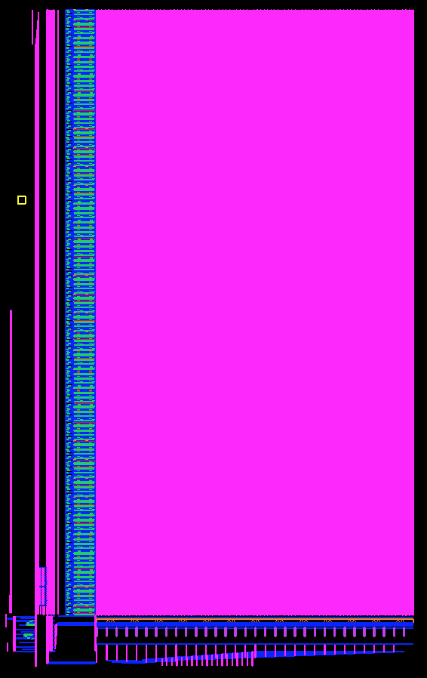
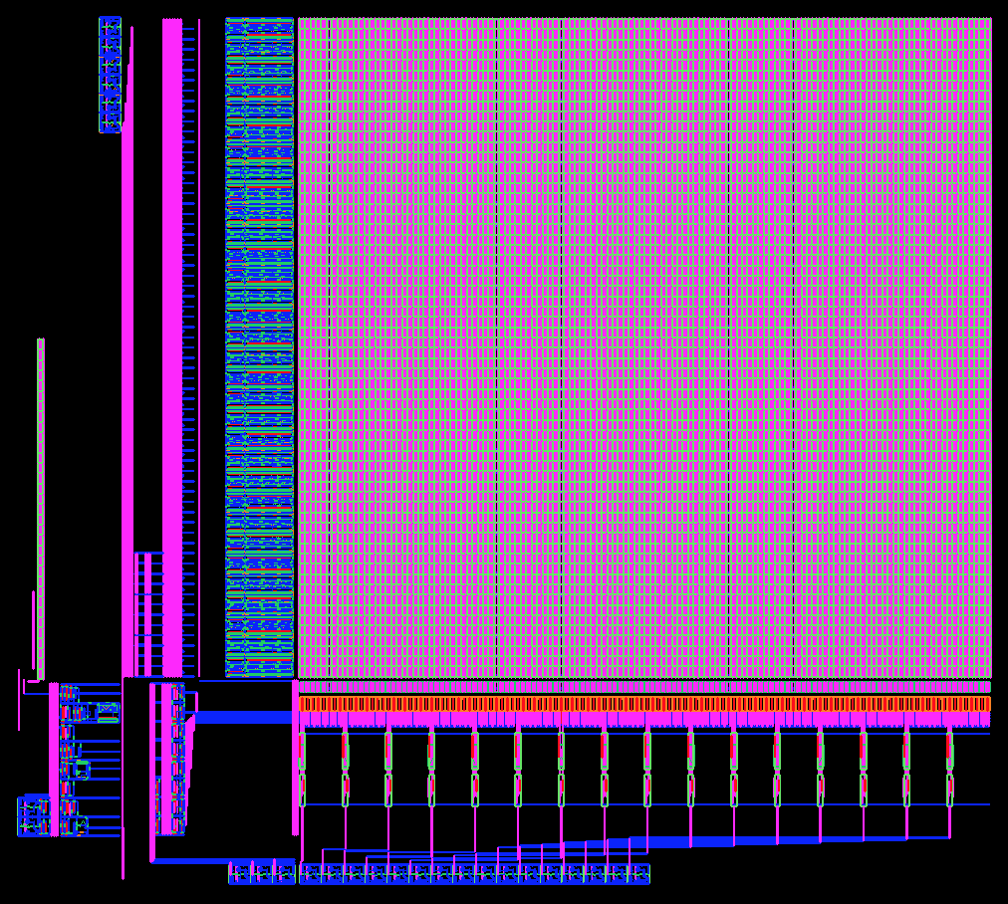
Small Layouts
512 x 16b x 1rw FreePDK45
2048 x 32b x 1rw FreePDK45

Slide 93
Relative Planar Bitcells
(0.35um SCMOS)
Standard 6T (1rw) 6.8um x 9.2um
Isolated Read 10T (1rw, 1r)
10.9um x 13.9um
DFF
21.9um x 21.2um
(from OSU standard cell library)

Slide 94
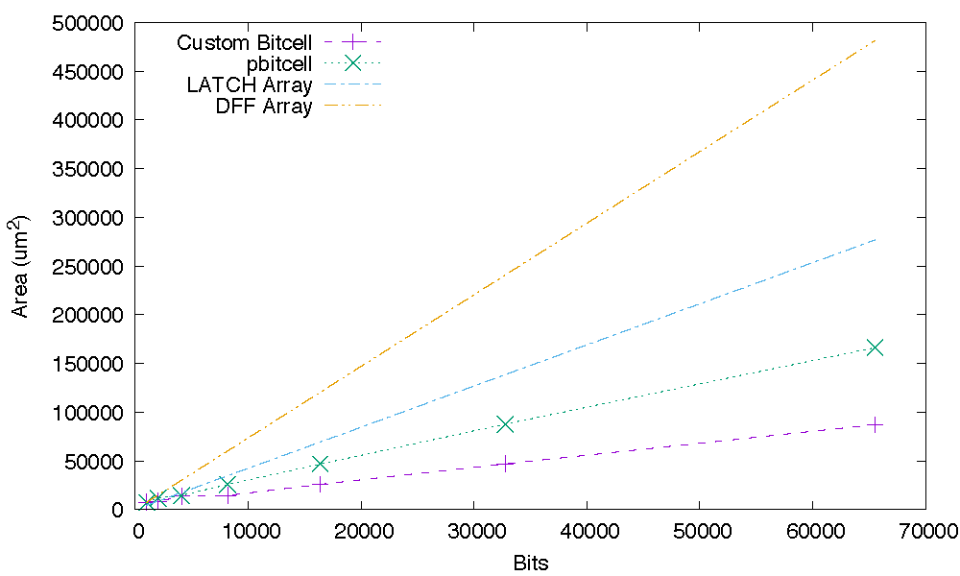
SRAM Area

Slide 95
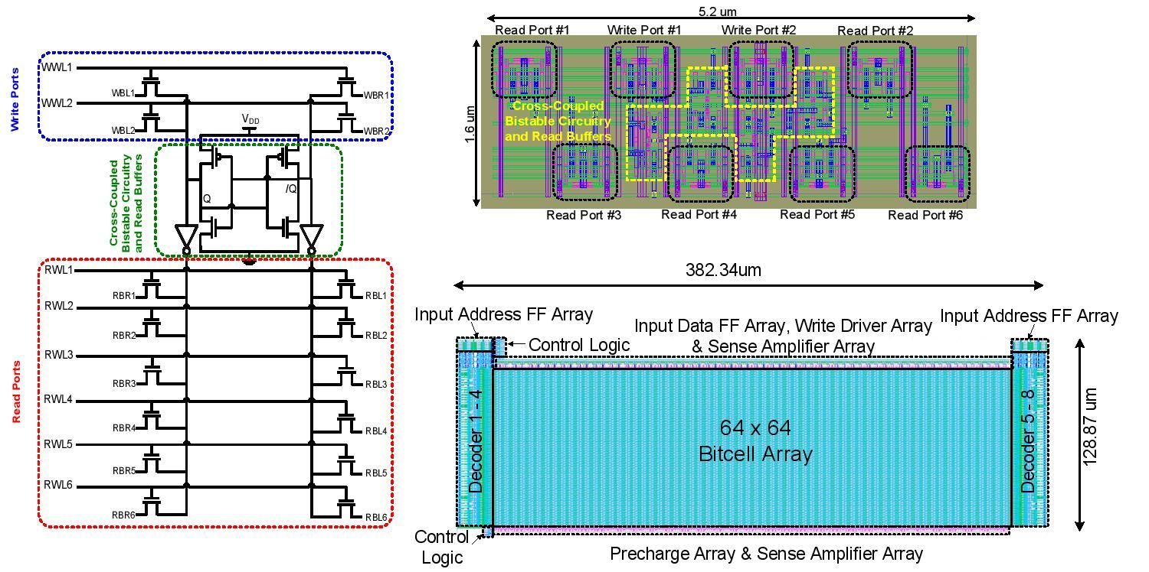
Generated Layout by OpenRAM for a multiport
(6R/2W) SRAM in 32 nm SOI CMOS Technology

Slide 96
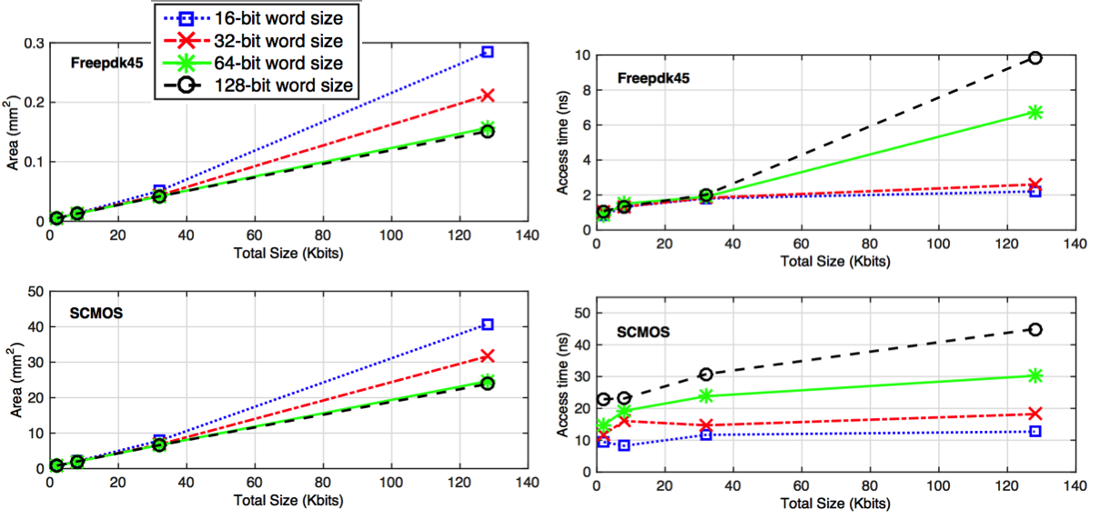
Timing and Density Results for Generated SRAMs

Slide 97
Comparison with Fabricated SRAMs
Ref. | Feature Size | Tech. | Density [Mb/mm2]
IEEE-VLSI’08 | 65 nm | CMOS | 0.7700
JSSC’11 | 45 nm | CMOS | 0.3300
JSSC’13 | 40 nm | CMOS | 0.9400
OpenRAM | 45 nm | FreePDK45 | 0.8260
JSSC’92 | 0.5 um | CMOS | 0.0036
JSSC’94 | 0.5 um | BICMOS | 0.0020
JSSC’99 | 0.5 um | CMOS | 0.0050
OpenRAM | 0.5 um | SCMOS | 0.0050

Slide 98
Conclusions
The main motivation behind OpenRAM is to promote and simplify memory-related research in academia and provides a platform to implement and test new memory designs.
OpenRAM is open-sourced, flexible, and portable and can be adapted to various technologies.
OpenRAM generates the circuit, functional model, and layout of variable-sized SRAMs.
OpenRAM provides a memory characterizer for synthesis timing/power models.
We are also actively introducing new features, such as non-6T memories, variability characterization, word-line segmenting, characterization speed-up, etc.

